Slide 1
Power Quality for Distribution System
ECpE Department
Dr. Zhaoyu Wang
1113 Coover Hall, Ames, IA
wzy@iastate.edu

Slide 2
Power Quality for Distribution System
Acknowledgement:
The slides are developed based in part on Electric Power and Energy Distribution Systems, Models, Methods and Applications, Subrahmanyan S. Venkata, Anil Pahwa, IEEE Press & Wiley, 2022
ECpE Department

Slide 3
1. Definition of Power Quality
Power quality (PQ) is related to receiving distortion-free electric supply, which is predominantly alternating current (ac). PQ, therefore, deals with the performance of signals in a distribution system or a portion of it.
While it is hard to maintain ideal signals for quantities such as voltage and current as perfect sinusoidal waves at constant frequency (60Hz in North America) and/or perfect direct current (dc) signals at constant magnitude, all efforts must be made to keep the behavior of signals as close to the ideal conditions as possible for any given distribution system.

Slide 4
1. Definition of Power Quality
Various issues that cause deviation from ideal conditions include harmonics, flicker, momentary events, noise, voltage fluctuations, and outages.
To conduct the PQ analysis, the use of Fourier series, Fourier transforms, and other signal analysis background is of paramount importance.

Slide 5
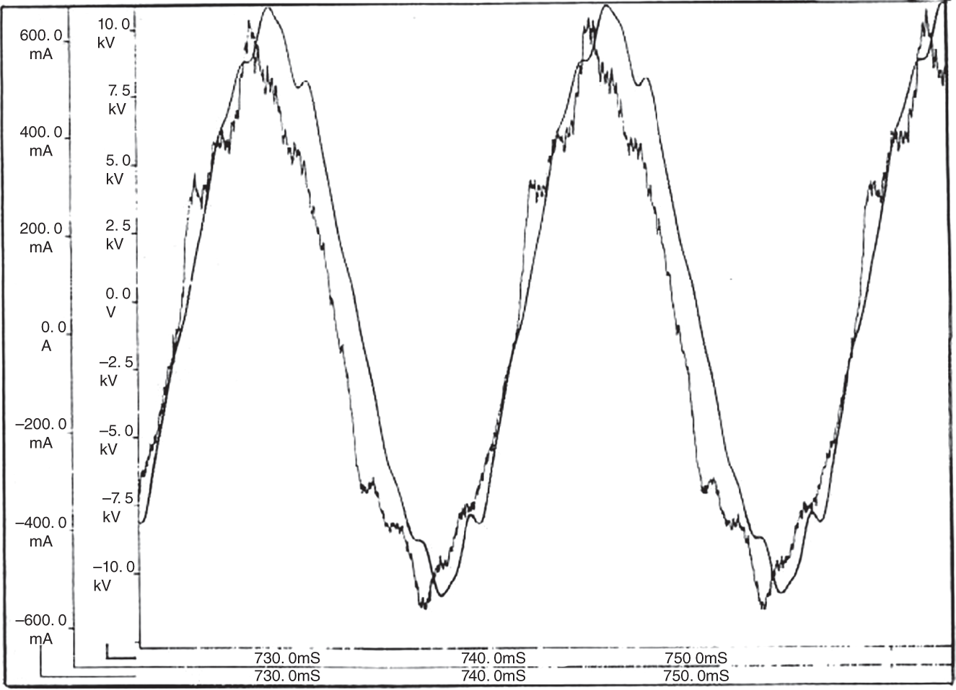
1. Definition of Power Quality
Distortion in voltage and current waveforms recorded (the highly distorted waveform is the current and less distorted waveform is the voltage) at a veneer plant is shown in Figure to illustrate the PQ problem.
Figure: Voltage and current waveforms recorded at a veneer plant.

Slide 6
1. Definition of Power Quality
To assure the highest level of performance of a distribution system, the PQ assessment is always needed since it is hard, if not impossible, to realize the ideal conditions mentioned above.
The best and practical approach is to make sure that the system performs as close to the ideal conditions as possible.
For this reason, standards such as IEEE-Std 519 have been developed to meet the stipulated levels of performance. Since many of the harmonic-related problems inject a periodic current signal, Fourier series is a powerful tool to determine the components of different frequencies in the signal.

Slide 7
2. Impacts of Power Quality
2.1 The Customer Side
Computers and communication equipment are susceptible to power system disturbances, which can lead to loss of data and to erratic operation.
Automated manufacturing processes such as paper-making machinery and chipmaking assembly lines can shut down even in the case of short voltage sags. Induction and synchronous motors can have excessive losses and heating due to harmonics.
Home electronic equipment is vulnerable to PQ problems: for example, blinking digital clocks due to interruption of power, and flickering lights.

Slide 8
2. Impacts of Power Quality
2.1 The Customer Side
Equipment and process control malfunction translates to high expense for replacement parts and also for downtime, with adverse effects on profitability and product quality.
While passive loads, such as incandescent lights and motors, do not create any harmonics when supplied by a sinusoidal voltage source, contemporary loads in houses, such as fluorescent lights, light emitting diode (LED) lights, computers, and other electronic equipment, create current harmonics.

Slide 9
2. Impacts of Power Quality
2.1 The Customer Side
Several of these loads depend on the conversion of ac supply voltage to dc for operation. This conversion process is the primary source of harmonics. Typically, harmonic problems are primarily associated with process-oriented industries; residential customers seldom experience any harmonic-related problems.

Slide 10
2. Impacts of Power Quality
2.2 The Utility Side
Poor PQ can cause failure of power‐factor correction capacitors due to the resonance condition.
It also causes increased losses in cables, transformers, and conductors, especially neutral wires; errors in energy meters, which are calibrated to operate under sinusoidal conditions, and incorrect operation of protective relays, particularly in solid‐state and microprocessor‐controlled systems.
PQ issues result not only in unhappy customers but also in malfunction and failure of system components and control systems, with adverse impact on profitability.

Slide 11
2. Impacts of Power Quality
2.3 Importance of Power Quality
PQ is important because it affects both the utilities as suppliers and the customers as users in many ways:
It increases losses on equipment, with increased loss of life of equipment, and higher downtime.
It causes metering errors and creates electromagnetic compatibility (EMC) issues including telephone interference and computer interference.
It degrades the quality of service to customers, increases cost, and decreases competitiveness of utilities.

Slide 12
2. Impacts of Power Quality
2.4 Cost of Power Quality
The cost of poor PQ is determined by adding: the cost of actions taken to improve PQ, the cost of customer losses in industrial production, and the payment to customers for improving PQ problems.
In addition, there is cost to the utility due to higher energy loss, extra cost to serve higher peak load, potential loss of revenue due to metering errors, and cost associated with reduced life of equipment.
According to an estimate by Electric Power Research Institute in the U. S. (EPRI) done in 2020, between $120B and $188B are spent annually for addressing the PQ problems. Hence, it is important to address PQ issues to reduce cost and improve the quality of service to customers.

Slide 13
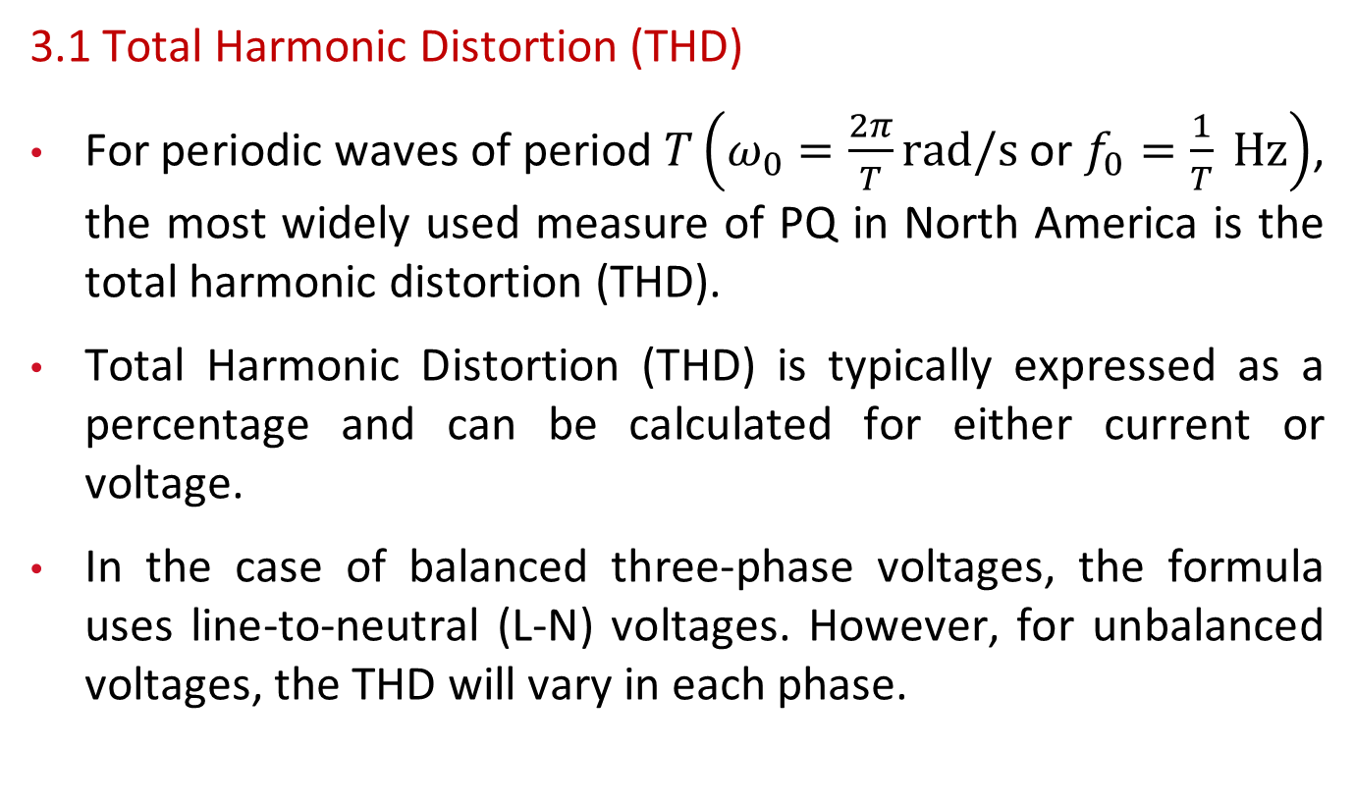
3. Harmonics and PQ Indices
3.1 Total Harmonic Distortion (THD)
For periodic waves of period $T\left(ω_{0}=\frac{2π}{T}rad/s\right.$ or $\left.f_{0}=\frac{1}{T} Hz\right)$, the most widely used measure of PQ in North America is the total harmonic distortion (THD).
Total Harmonic Distortion (THD) is typically expressed as a percentage and can be calculated for either current or voltage.
In the case of balanced three-phase voltages, the formula uses line-to-neutral (L-N) voltages. However, for unbalanced voltages, the THD will vary in each phase.

Slide 14
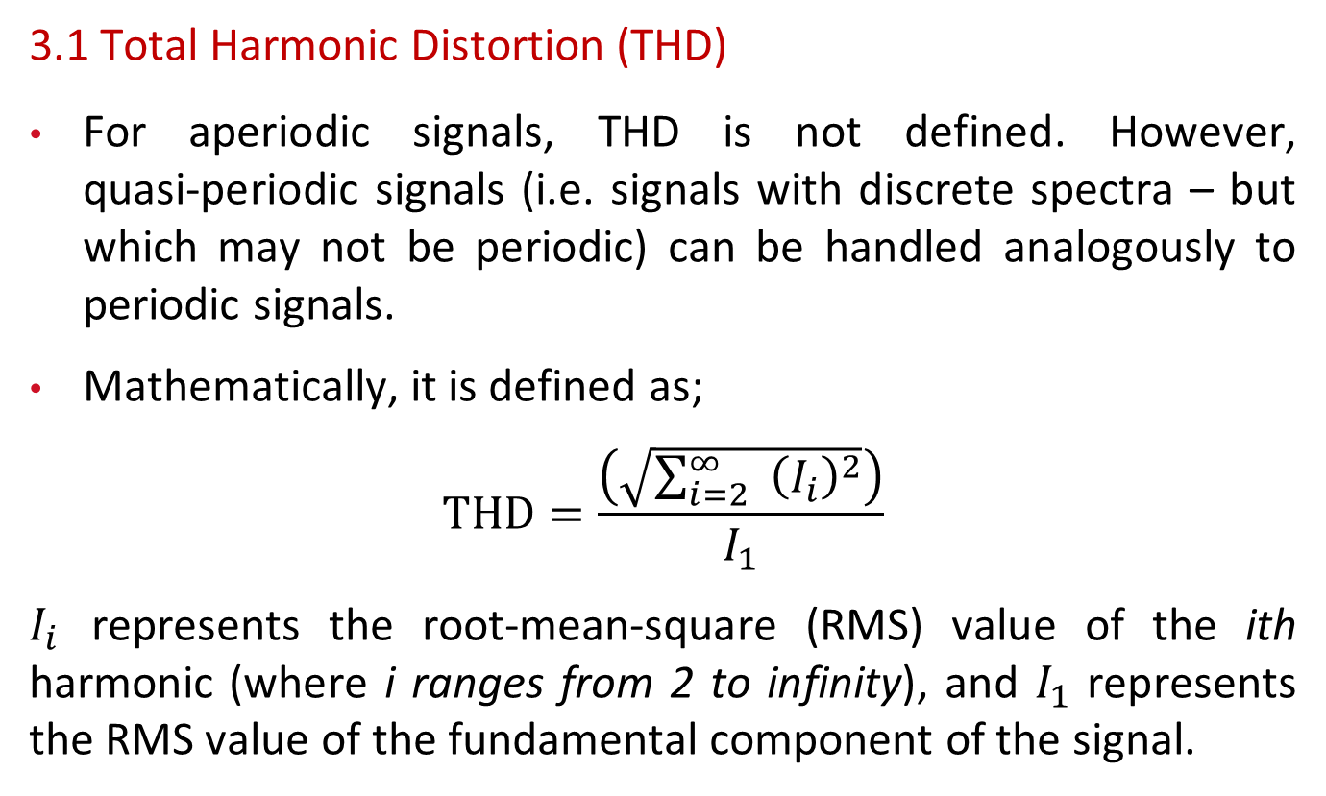
3. Harmonics and PQ Indices
3.1 Total Harmonic Distortion (THD)
For aperiodic signals, THD is not defined. However, quasi‐periodic signals (i.e. signals with discrete spectra – but which may not be periodic) can be handled analogously to periodic signals.
Mathematically, it is defined as;
$$THD=\frac{\left(\sqrt{\sum_{i=2}^{∞}{ } {\left(I_{i}\right)}^{2}}\right)}{I_{1}}$$
$I_{i}$ represents the root-mean-square (RMS) value of the ith harmonic (where i ranges from 2 to infinity), and $I_{1}$ represents the RMS value of the fundamental component of the signal.

Slide 15
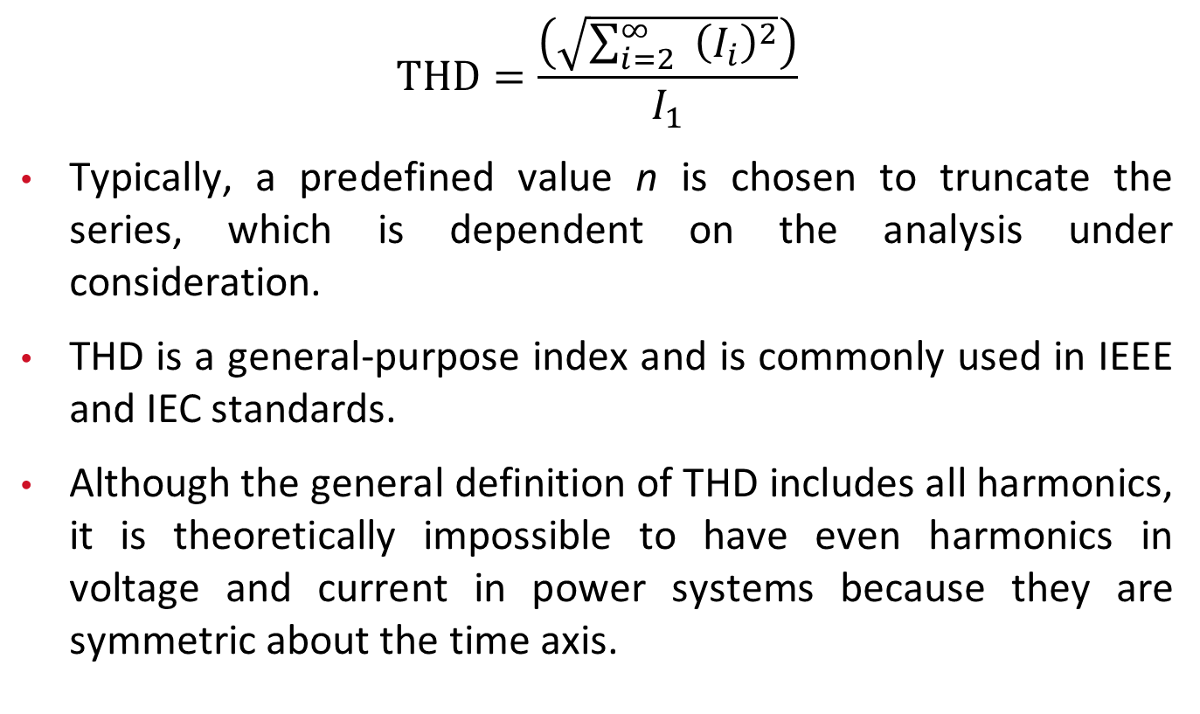
3. Harmonics and PQ Indices
$$THD=\frac{\left(\sqrt{\sum_{i=2}^{∞}{ } {\left(I_{i}\right)}^{2}}\right)}{I_{1}}$$
Typically, a predefined value n is chosen to truncate the series, which is dependent on the analysis under consideration.
THD is a general‐purpose index and is commonly used in IEEE and IEC standards.
Although the general definition of THD includes all harmonics, it is theoretically impossible to have even harmonics in voltage and current in power systems because they are symmetric about the time axis.

Slide 16
3. Harmonics and PQ Indices
3.1.1 Properties of THD
THD is zero for a perfectly sinusoidal waveform. It becomes indefinitely large as distortion increases.
If the fundamental term has amplitude zero, THD becomes infinity.
For example, let v(t) = cos(5t) + cos(7t). Let ω₀ be the fundamental frequency. Therefore, 5 = kω₀ and 7 = mω₀, and (5/7) = (k/m). Subsequently, the smallest integer solution is k = 5 and m = 7, and ω₀ = 1 rad/s.
The Fourier series of v(t) is v(t) = 0*cos(t) + cos(5t) + cos(7t). Since the amplitude of the fundamental component, which is the denominator in THD, is zero, THD becomes infinity.

Slide 17
3. Harmonics and PQ Indices
3.1.1 Properties of THD
On the other hand, if a single harmonic of frequency h dominates the frequency spectrum of a signal above ω₀, the THD is given by I_{h}/I₁.
A commonly cited figure of 5% THD is the dividing line between the high and low harmonic distortions. However, caution should be exercised in using the 5% distortion figure, as it may be too high for sub-transmission and transmission circuits but acceptable for distribution circuits.

Slide 18
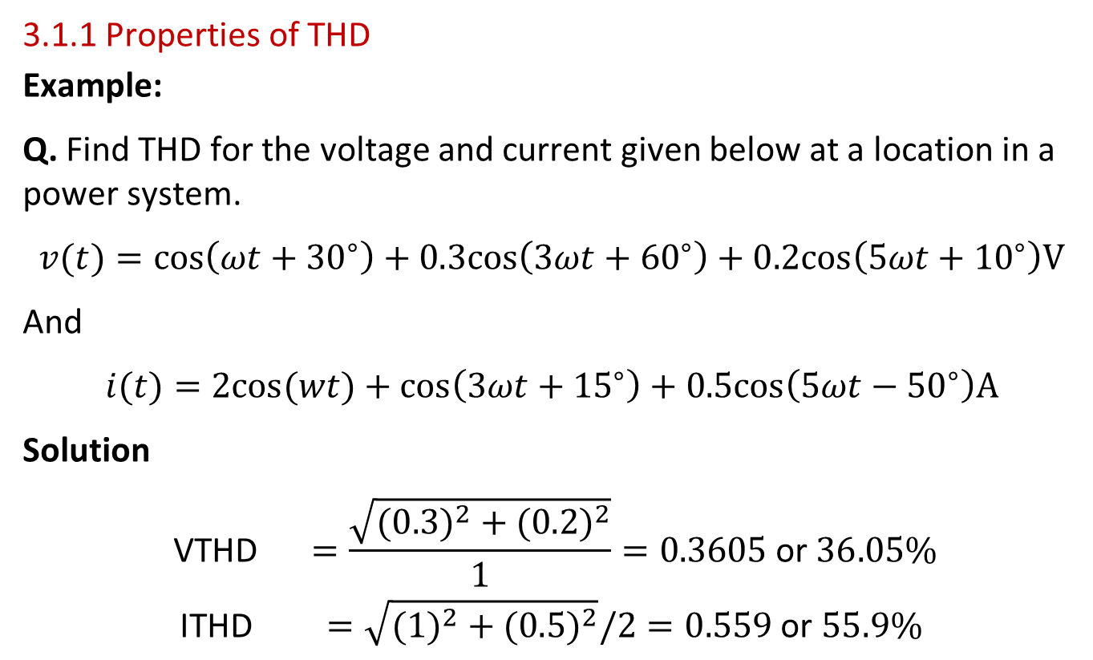
3. Harmonics and PQ Indices
3.1.1 Properties of THD
Example:
Q. Find THD for the voltage and current given below at a location in a power system.
$$v(t)=cos\left(ωt+{30}^{∘}\right)+0.3cos\left(3ωt+{60}^{∘}\right)+0.2cos\left(5ωt+{10}^{∘}\right)V$$
And
$$i(t)=2cos(wt)+cos\left(3ωt+{15}^{∘}\right)+0.5cos\left(5ωt−{50}^{∘}\right)A$$
Solution
$$\begin{matrix} \text{VTHD} & =\frac{\sqrt{(0.3)^{2}+(0.2)^{2}}}{1}=0.3605 \text{or} 36.05\% \\ \text{ITHD} & =\sqrt{(1)^{2}+(0.5)^{2}}/2=0.559 \text{or} 55.9\%\end{matrix}$$

Slide 19
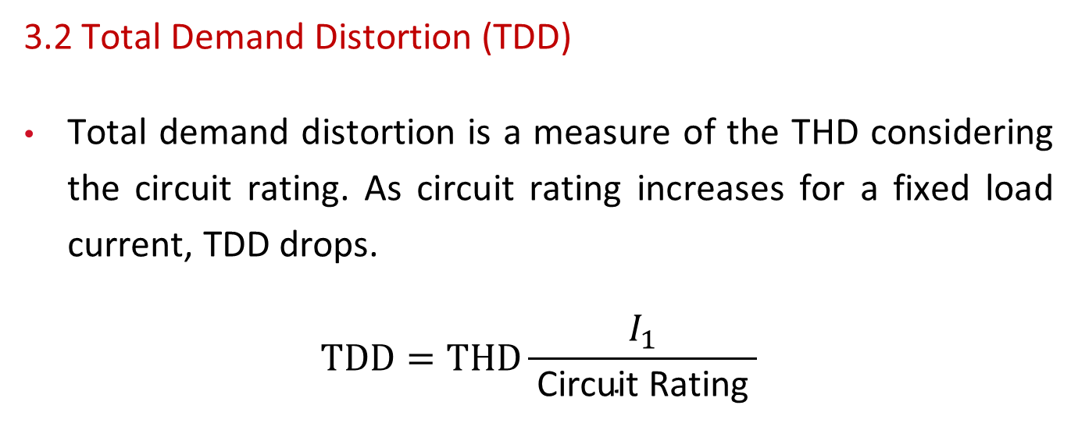
3. Harmonics and PQ Indices
3.2 Total Demand Distortion (TDD)
Total demand distortion is a measure of the THD considering the circuit rating. As circuit rating increases for a fixed load current, TDD drops.
$$TDD=THD\frac{I_{1}}{ \text{Circuit} \text{Rating} }$$

Slide 20
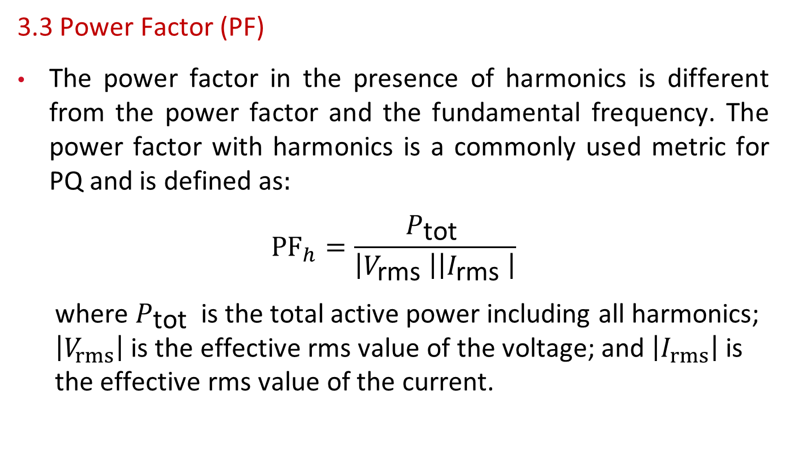
3. Harmonics and PQ Indices
3.3 Power Factor (PF)
The power factor in the presence of harmonics is different from the power factor and the fundamental frequency. The power factor with harmonics is a commonly used metric for PQ and is defined as$:$
$${PF}_{h}=\frac{P_{\text{tot} }}{\left|V_{\text{rms} }\right|\left|I_{\text{rms} }\right|}$$
  where $P_{\text{tot} }$ is the total active power including all harmonics; $\left|V_{rms}\right|$ is the effective rms value of the voltage; and $\left|I_{rms}\right|$ is the effective rms value of the current.

Slide 21
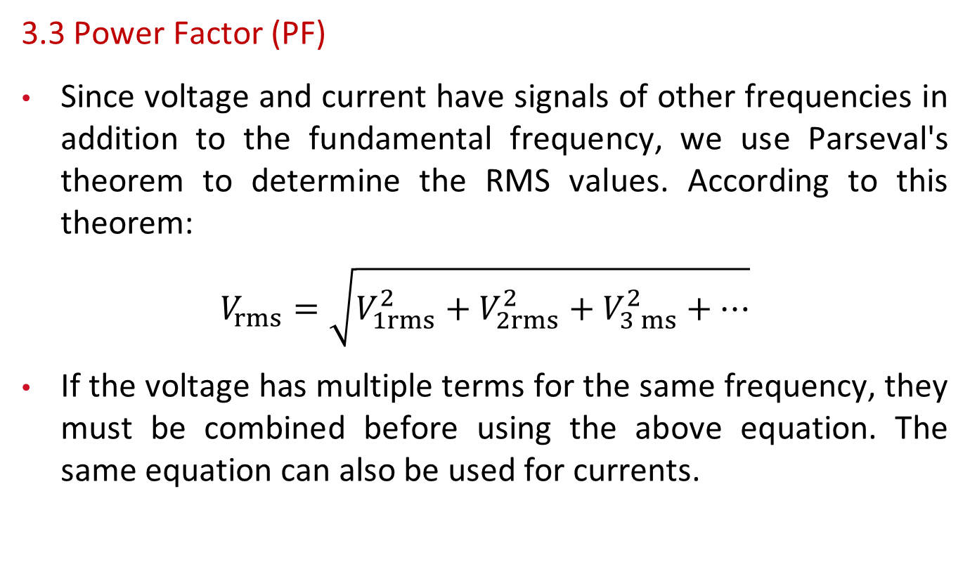
3. Harmonics and PQ Indices
3.3 Power Factor (PF)
Since voltage and current have signals of other frequencies in addition to the fundamental frequency, we use Parseval's theorem to determine the RMS values. According to this theorem:
$$V_{rms}=\sqrt{V_{1rms}^{2}+V_{2rms}^{2}+V_{3 ms}^{2}+…}$$
If the voltage has multiple terms for the same frequency, they must be combined before using the above equation. The same equation can also be used for currents.

Slide 22
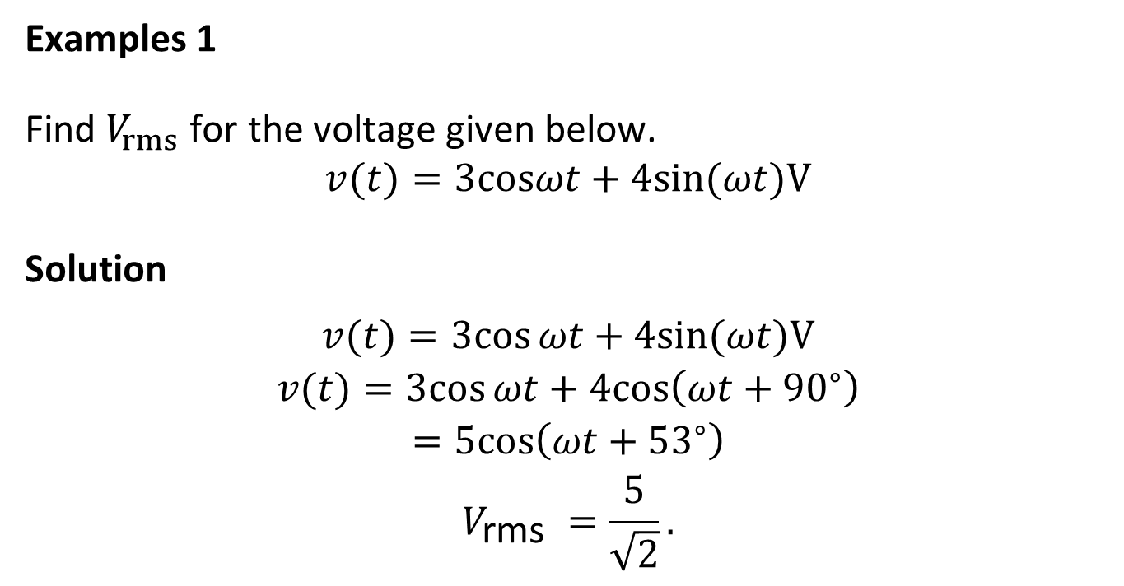
3. Harmonics and PQ Indices
Examples 1
Find $V_{rms}$ for the voltage given below.
$$v(t)=3cosωt+4sin(ωt)V$$
Solution
$$\begin{matrix}v(t)=3cos⁡ωt+4sin⁡(ωt)V \\ v(t)=3cos⁡ωt+4cos⁡\left(ωt+{90}^{∘}\right) \\ =5cos⁡\left(ωt+{53}^{∘}\right) \\ V_{\text{r}\text{m}\text{s} }=\frac{5}{\sqrt{2}}.\end{matrix}$$

Slide 23
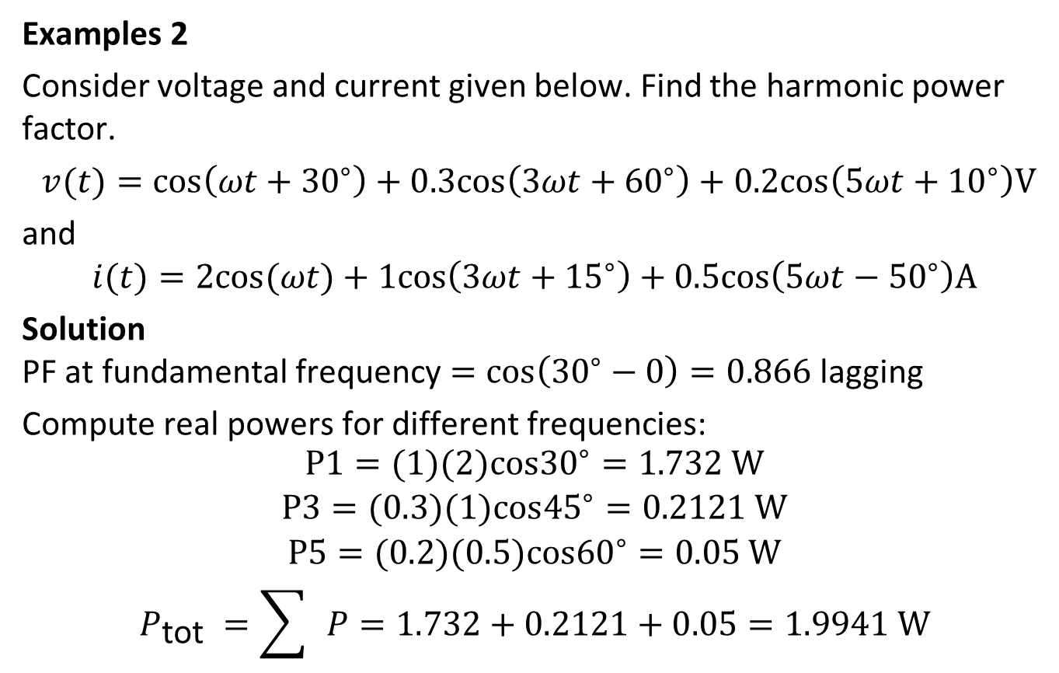
3. Harmonics and PQ Indices
Examples 2
Consider voltage and current given below. Find the harmonic power factor.
$v(t)=cos⁡\left(ωt+{30}^{∘}\right)+0.3cos⁡\left(3ωt+{60}^{∘}\right)+0.2cos⁡\left(5ωt+{10}^{∘}\right)V$
and
$$i(t)=2cos⁡(ωt)+1cos⁡\left(3ωt+{15}^{∘}\right)+0.5cos⁡\left(5ωt−{50}^{∘}\right)A$$
Solution
PF at fundamental frequency $=cos\left({30}^{∘}−0\right)=0.866$ lagging
Compute real powers for different frequencies:
$$\begin{matrix}P1=(1)(2)cos{30}^{∘}=1.732 W \\ \begin{matrix}P3=(0.3)(1)cos{45}^{∘}=0.2121 W \\ P5=(0.2)(0.5)cos{60}^{∘}=0.05 W \\ P_{\text{tot} }=\sum{ }P=1.732+0.2121+0.05=1.9941 W\end{matrix}\end{matrix}$$

Slide 24
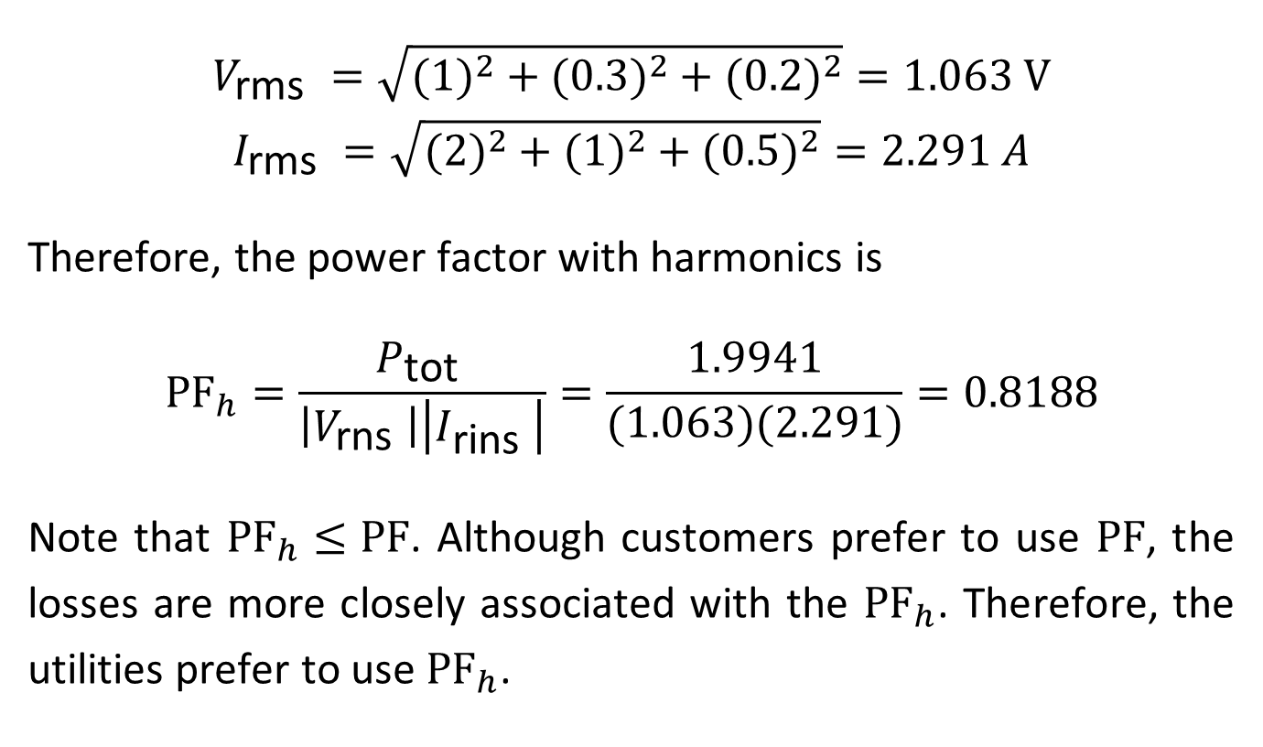
3. Harmonics and PQ Indices
$$\begin{matrix}V_{\text{rms} }=\sqrt{(1)^{2}+(0.3)^{2}+(0.2)^{2}}=1.063 V \\ I_{\text{rms} }=\sqrt{(2)^{2}+(1)^{2}+(0.5)^{2}}=2.291 A\end{matrix}$$
Therefore, the power factor with harmonics is
$${PF}_{h}=\frac{P_{\text{tot} }}{\left|V_{\text{rns} }\right|\left|I_{\text{rins} }\right|}=\frac{1.9941}{(1.063)(2.291)}=0.8188$$
Note that ${PF}_{h}≤PF$. Although customers prefer to use $PF$, the losses are more closely associated with the ${PF}_{h}$. Therefore, the utilities prefer to use ${PF}_{h}$.

Slide 25
3.4 Standards for Harmonic Control
Various international organizations have developed PQ standards. IEEE has several standards including IEEE Std 519‐2014, which is dedicated to harmonic control in electric power systems.
The philosophy of this standard is that the utility is responsible for maintaining the quality of voltage waveform, and the customer is responsible for limiting harmonic currents injected onto the power system.
Accordingly, the standard specifies voltage and current distortion limits at the point of common coupling.

Slide 26
3.4 Standards for Harmonic Control
The recommended distortion for bus voltage below 1 kV is 5% for individual harmonic and 8% for THD. For buses above 1 kV but below 69 kV, the limits are 3% for individual harmonic and 5% for THD.
For bus voltages between 1 kV and 69 kV, the limits are 3% for individual harmonics and 5% for THD, with further reductions for higher voltages.

Slide 27
3.4 Standards for Harmonic Control
For systems of voltages rated 120 V to 69 kV with the ratio of short‐circuit current to maximum load demand current (short‐circuit ratio or ) at fundamental frequency less than 20, the limits as percentages of maximum demand load current are specified in the Table for different odd harmonics.
Harmonic order (odd harmonics) | Maximum % distortion
3–9 | 4.0
11–15 | 2.0
17–21 | 1.5
23–33 | 0.6
35–50 | 0.3
TDD | 5.0
Table: Current distortion limits for systems rated 120V through 69 kV for SCR ratio less than 20.

Slide 28
3.4 Standards for Harmonic Control
The maximum demand load current is defined as the sum of the currents corresponding to the maximum demand during each of the 12 previous months divided by 12.
For systems with higher SCR ratios, higher current distortion values are acceptable. This is due to the fact that higher short‐circuit current implies lower equivalent source impedance, which will result in lower voltage drop and thus lower voltage distortion at the point of common coupling (PCC).

Slide 29
3.4 Standards for Harmonic Control
Even harmonics are limited to 25% of the odd harmonic limits as specified in the Table.
Current distortions that result in a dc offset, such as half‐wave rectifiers, are not allowed.
IEEE Std 519‐2014 also provides values for maximum allowed distortion for systems with higher short‐circuit current to maximum load demand current.
The readers are referred to this specific standard for additional information.

Slide 30
3.4 Standards for Harmonic Control
Example 1
A distribution system has a short-circuit impedance 0+j0.05 per unit on a 0.333 -MVA, 7800-V base (this is a single-phase system). If a load effectively injects 1A at the fifth harmonic into the bus, estimate the fifth harmonic voltage that results in the system.

Slide 31
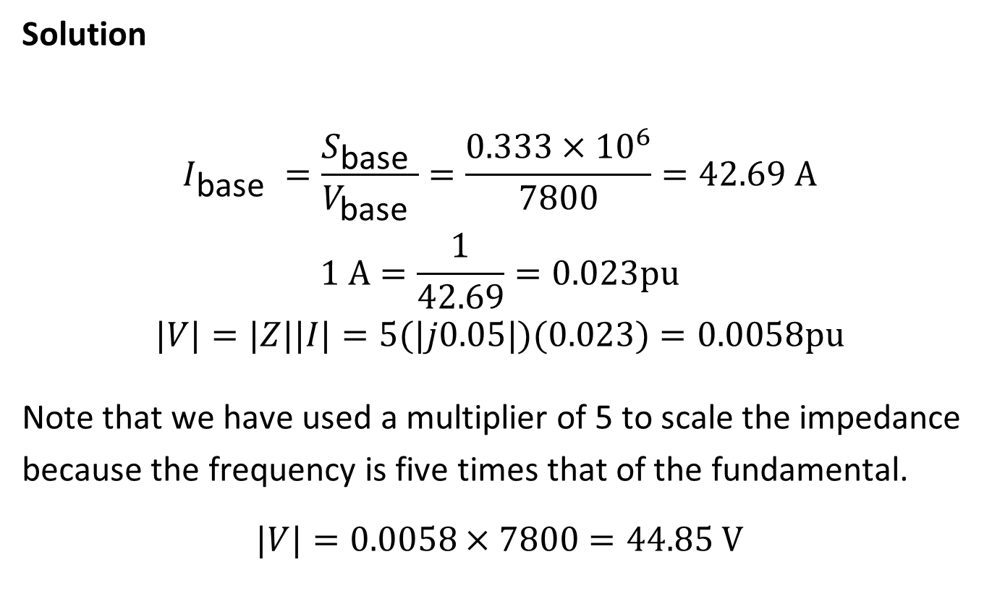
3.4 Standards for Harmonic Control
Solution
$$\begin{matrix}I_{\text{base} }=\frac{S_{\text{base} }}{V_{\text{base} }}=\frac{0.333×{10}^{6}}{7800}=42.69 A \\ 1 A=\frac{1}{42.69}=0.023pu \\ |V|=|Z||I|=5(|j0.05|)(0.023)=0.0058pu\end{matrix}$$
Note that we have used a multiplier of 5 to scale the impedance because the frequency is five times that of the fundamental.
$$|V|=0.0058×7800=44.85 V$$

Slide 32
3.4 Standards for Harmonic Control
Example 2
A residence has a dedicated single‐phase distribution transformer rated 27.5 kVA, 12.47 kV/120 V, and 8.1% reactance. Estimate the maximum third harmonic current that can be taken from the transformer by a nonlinear load in this residence. Consider the impedance of the feeder to be 0.0508 + j49.230 Ω and maximum load demand current to be 60% of the current at rated value and use reasonable assumption for the SCR.

Slide 33
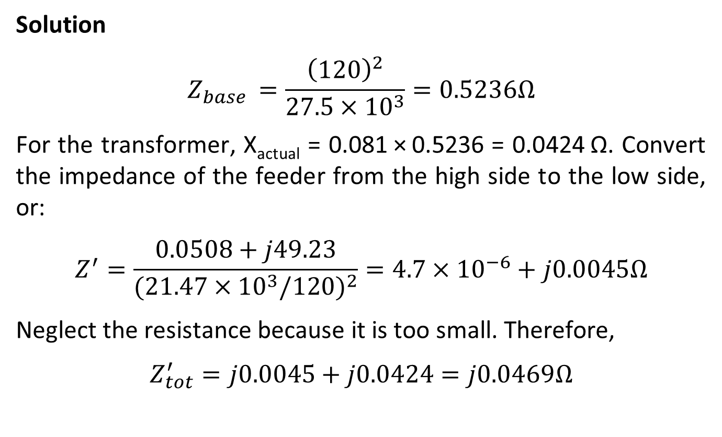
3.4 Standards for Harmonic Control
Solution
$$Z_{base }=\frac{{\left(120\right)}^{2}}{27.5×{10}^{3}}=0.5236Ω$$
For the transformer, X_{actual} = 0.081 × 0.5236 = 0.0424 Ω. Convert the impedance of the feeder from the high side to the low side, or:
$$Z^{′}=\frac{0.0508+j49.23}{{(21.47×{10}^{3}/120)}^{2}}=4.7×{10}^{−6}+j0.0045Ω$$
Neglect the resistance because it is too small. Therefore,
$$Z_{tot}^{′}=j0.0045+j0.0424=j0.0469Ω$$

Slide 34
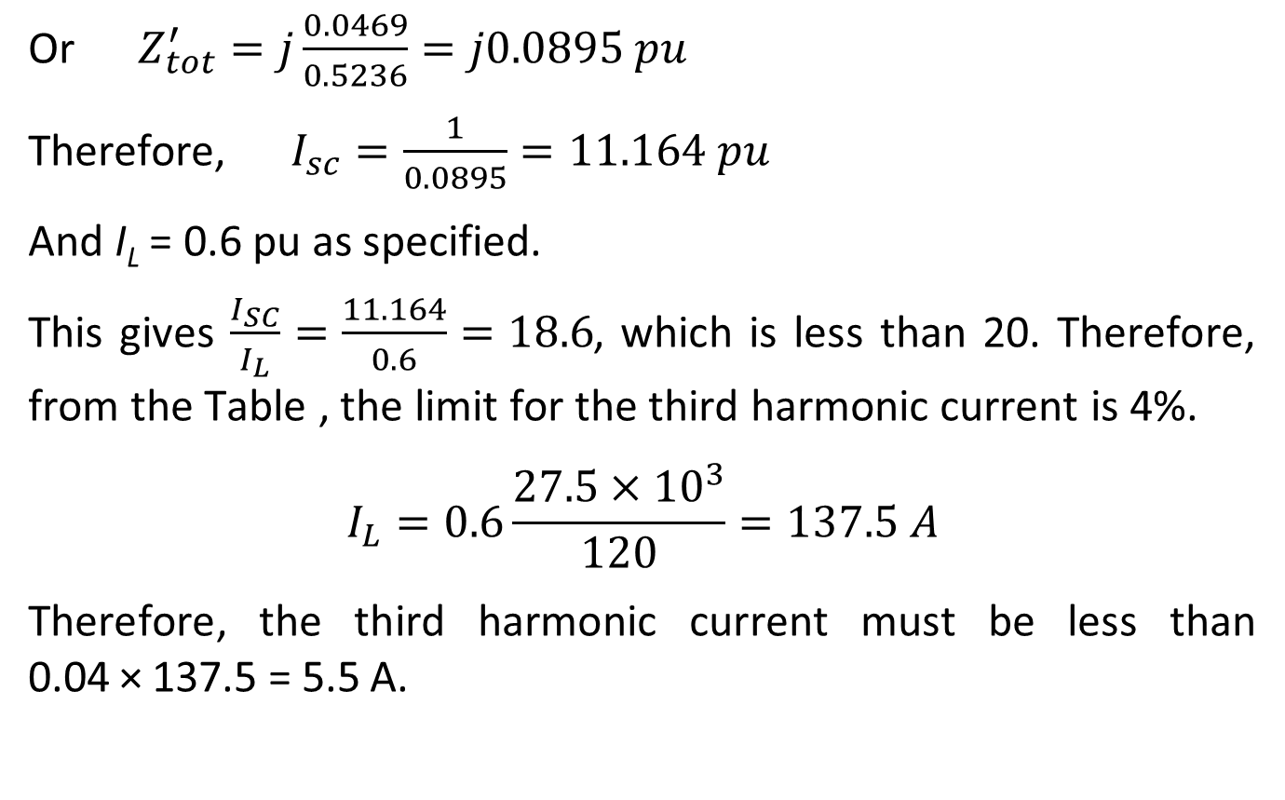
3.4 Standards for Harmonic Control
Or $Z_{tot}^{′}=j\frac{0.0469}{0.5236}=j0.0895 pu$
Therefore, $I_{sc}=\frac{1}{0.0895}=11.164 pu$
And I_{L} = 0.6 pu as specified.
This gives $\frac{I_{SC}}{I_{L}}=\frac{11.164}{0.6}=18.6$, which is less than 20. Therefore, from the Table , the limit for the third harmonic current is 4%.
$$I_{L}=0.6\frac{27.5×{10}^{3}}{120}=137.5 A$$
Therefore, the third harmonic current must be less than 0.04 × 137.5 = 5.5 A.

Slide 35
4. Momentary Interruptions
Momentary interruptions occur in distributions systems due to the operation of reclosers or reclosing circuit breakers while trying to clear temporary faults and fuse‐saving operation.
While momentary interruptions are mainly considered a reliability issue, they are also a PQ issue because they cause inconvenience to customers by requiring them to reset clocks, switch off computers, and reset industrial process equipment.

Slide 36
4. Momentary Interruptions
For reliability consideration, the interruption duration for a momentary interruption is defined as five minutes, but for PQ, the duration is much smaller.
IEEE Standard 519‐1995 provides a PQ definition of momentary interruptions as: A type of short duration variation. The complete loss of voltage (<0.1 pu) on one or more phases for a time period between 0.5 cycles and 3 seconds.

Slide 37
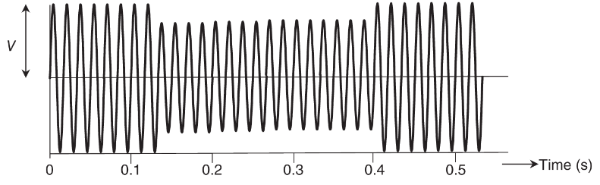
5. Voltage Sag and Swell
5.1 Definition
Voltage sags are defined as reduction in rms value of voltage for a duration up to a few seconds. Figure illustrates an example of voltage sag. Sags are usually caused by starting of heavy loads or faults in the system.
Figure: Example of Voltage Sag.

Slide 38
5. Voltage Sag and Swell
5.1 Definition
The duration of a voltage sag is the time taken by the system to return to a normal state after the switched load has stabilized or by the protective device to clear the fault.
While most of the equipment owned by customers can ride through short duration sags, long duration sags can be detrimental to equipment.
Sags can also have a transient in the beginning in some cases. These transients are not shown in Figure.

Slide 39
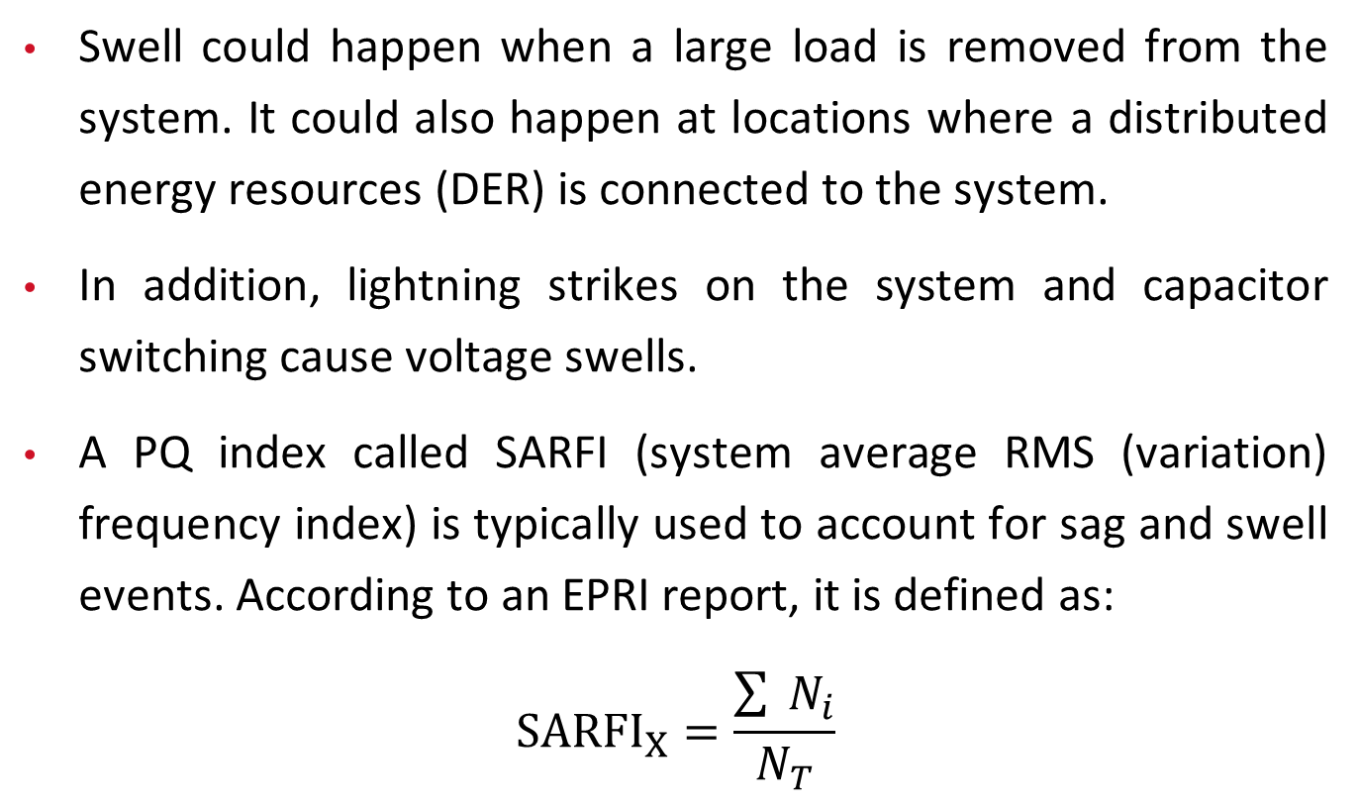
5. Voltage Sag and Swell
Swell could happen when a large load is removed from the system. It could also happen at locations where a distributed energy resources (DER) is connected to the system.
In addition, lightning strikes on the system and capacitor switching cause voltage swells.
A PQ index called SARFI (system average RMS (variation) frequency index) is typically used to account for sag and swell events. According to an EPRI report, it is defined as:
$${SARFI}_{X}=\frac{\sum{ }N_{i}}{N_{T}}$$

Slide 40
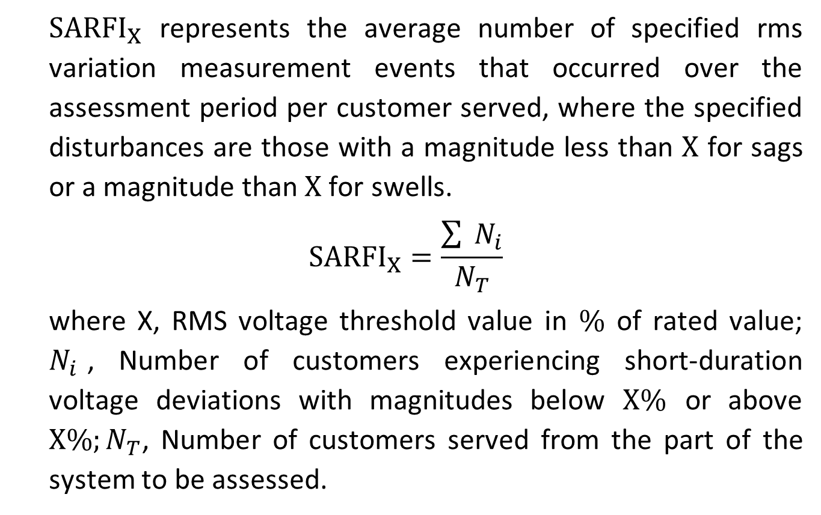
5. Voltage Sag and Swell
  ${SARFI}_{X}$ represents the average number of specified rms variation measurement events that occurred over the assessment period per customer served, where the specified disturbances are those with a magnitude less than $X$ for sags or a magnitude than $X$ for swells.
$${SARFI}_{X}=\frac{\sum{ }N_{i}}{N_{T}}$$
  where X, RMS voltage threshold value in $\%$ of rated value; $N_{i}$, Number of customers experiencing short-duration voltage deviations with magnitudes below $X\%$ or above $X\%;N_{T}$, Number of customers served from the part of the system to be assessed.

Slide 41
5. Voltage Sag and Swell
Determining this index would require monitoring voltage at selected locations. While this index is similar to reliability indices, it is difficult to extend it to find system wide values because that would require a large number of locations for voltage monitoring.

Slide 42
5. Voltage Sag and Swell
5.2 ITI (CBEMA) Curve
While most of the equipment can tolerate sags and swells, Information Technology Equipment (ITE) is sensitive to them.
To address this issue, Information Technology Industry Council (ITI, formerly known as the Computer & Business Equipment Manufacturer's Association) has set voltage ride through design specifications for ITE and distribution systems.

Slide 43
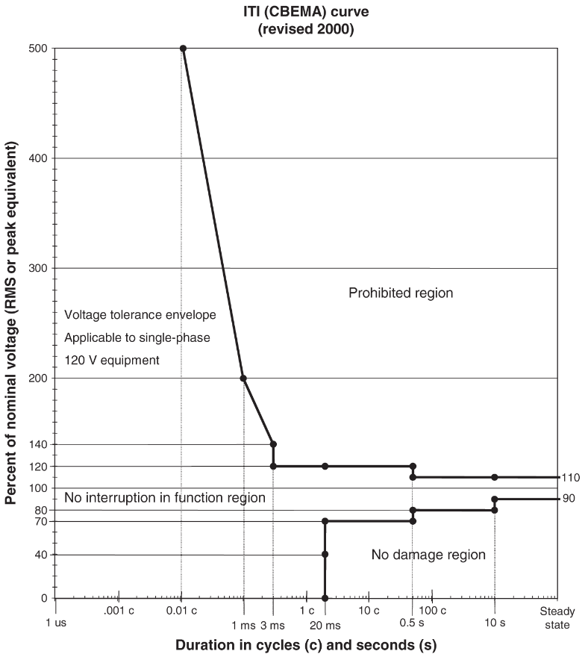
5. Voltage Sag and Swell
The ITI (CBEMA) curve shown in the Figure applies to nominal voltage of 120 V RMS at 60 Hz. The curve has three regions along with the voltage tolerance envelope.
Accordingly, large swell and sag can take place if they are for extremely short durations. The range of voltages shrinks as the duration increases. Nominal voltage between 90% and 110% is permitted for an indefinite duration.
Figure: Voltage sag and swell limits for information technology equipment.

Slide 44
5. Voltage Sag and Swell
Events in the No Damage Region will not permit normal operation of the equipment, but no damage to the equipment is expected.
Events in the No Damage Region will not permit normal operation of the equipment, but no damage to the equipment is expected.
Figure: Voltage sag and swell limits for information technology equipment.

Slide 45
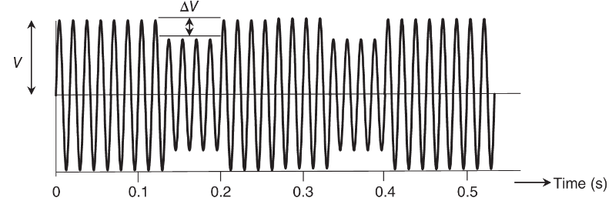
6. Flicker
Voltage flicker is fluctuation of voltage amplitude at a frequency much lower than the power frequency. Periodic switching on of large loads such as sawmills, irrigation pumps, welding machines, and elevators can cause flicker.
Figure attached illustrates an example where the voltage amplitude periodically drops by ΔV.
Figure: Example of periodic voltage change that causes flicker

Slide 46
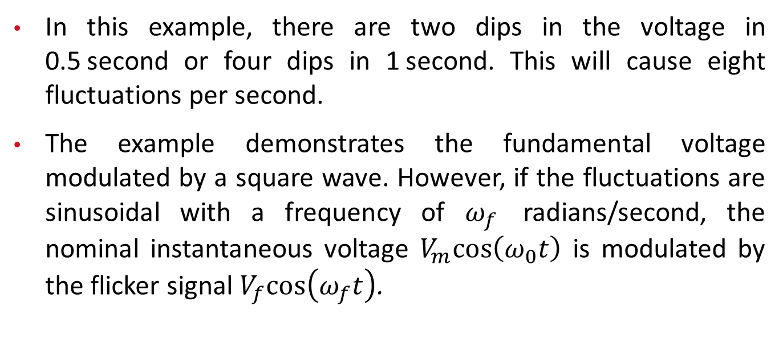
6. Flicker
In this example, there are two dips in the voltage in 0.5 second or four dips in 1 second. This will cause eight fluctuations per second.
The example demonstrates the fundamental voltage modulated by a square wave. However, if the fluctuations are sinusoidal with a frequency of $ω_{f}$ radians/second, the nominal instantaneous voltage $V_{m}cos\left(ω_{0}t\right)$ is modulated by the flicker signal $V_{f}cos\left(ω_{f}t\right)$.

Slide 47
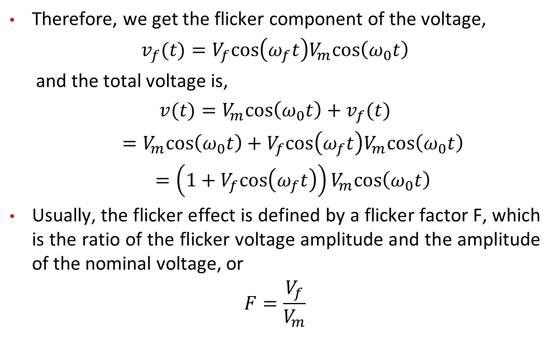
6. Flicker
Therefore, we get the flicker component of the voltage,
$v_{f}(t)=V_{f}cos⁡\left(ω_{f}t\right)V_{m}cos⁡\left(ω_{0}t\right)$
  and the total voltage is,
$v(t)=V_{m}cos⁡\left(ω_{0}t\right)+v_{f}(t)$
$=V_{m}cos⁡\left(ω_{0}t\right)+V_{f}cos⁡\left(ω_{f}t\right)V_{m}cos⁡\left(ω_{0}t\right)$
$=\left(1+V_{f}cos\left(ω_{f}t\right)\right)V_{m}cos\left(ω_{0}t\right)$
Usually, the flicker effect is defined by a flicker factor F, which is the ratio of the flicker voltage amplitude and the amplitude of the nominal voltage, or
$$F=\frac{V_{f}}{V_{m}}$$

Slide 48
6. Flicker
Cases where motors start only a few times in a day are considered special cases of flicker. Although there is no periodic flicker signal, motor start draws current that is five to six times larger than the normal current.
Voltage drops suddenly cause lights to dim and return to normal in a few seconds. Utilities usually have a criterion for voltage drop during motor starts. Most utilities use a limit of 3% for voltage drop.

Slide 49
Thank You!

